Slide 1


0
CMR ENGINEERING COLLEGE
(UGC AUTONOMOUS)
(Accredited by NBA, Approved by AICTE NEW DELHI, Affiliated to JNTU, Hyderabad)
Kandlakoya, Medchal Road, Hyderabad-501 401.
Department of Computer Science & Engineering
A Mini Project
On
LEAF DISEASE DETECTION
USING DEEPLEARNING
Internal Guide:-
Mr. M.Prabhakar ,
Assistant Professor,
Dept. of CSE.
A.Y 2024-2025
Presented By
P.Kamal Kumar (218R1A05O1)
S.Rajender (218R1A05P3)
B.Vidya Sagar Rao (218R1A05K3)
S.Ashmitha (218R1A05O9)

Slide 2
CONTENTS
Abstract
Aim
Objectives
Introduction
Literature Survey
Existing system
Drawbacks of existing system
Proposed system
Advantages
System Architecture
Modules
System Requirements (Software & Hardware)
System Design
Output Screens
Future Enhancement
Conclusion
References

Slide 3
ABSTRACT
The project titled "Leaf Disease Detection Using Deep Learning" aims to leverage advanced machine learning techniques to identify and classify diseases affecting plant leaves. Traditional methods of leaf disease detection, including manual inspection and chemical tests, are not only labor-intensive but also prone to inaccuracies. By employing deep learning, specifically Convolutional Neural Networks (CNNs), this project seeks to automate the detection process, enhancing both the accuracy and efficiency of diagnosing leaf diseases. The system will process leaf images, classify them into healthy or diseased categories, and identify the type of disease with high confidence. This approach is expected to significantly reduce the time required for disease detection, leading to timely intervention and improved crop management.

Slide 4
Aim
The main goal of my project, "Leaf Disease Detection Using Deep Learning," is to accurately identify and classify various diseases affecting plant leaves. By analyzing images of leaves, the system aims to assist farmers and agriculturists in early disease detection, thereby improving crop yield and reducing economic losses.
To achieve this, the project employs a deep learning model trained on a large dataset of leaf images. The system uses convolutional neural networks (CNNs) to process the images and identify disease patterns with high precision. The results demonstrate that this approach provides reliable and efficient disease detection, significantly outperforming traditional methods.

Slide 5
OBJECTIVES
Analyze a large dataset of leaf images to identify and classify various plant diseases accurately.
Develop a deep learning model using convolutional neural networks (CNNs) to efficiently detect and diagnose diseases from leaf images.
Investigate the feasibility and effectiveness of using deep learning techniques for early disease detection in plants.
Examine the potential of automated disease detection systems to assist farmers and agriculturists in improving crop yield and reducing economic losses.
Enhance our understanding of plant disease patterns by leveraging advanced image processing and deep learning algorithms.

Slide 6
INTRODUCTION
Leaf disease detection has become one of the most critical aspects of precision agriculture. The task is to automatically identify and classify various plant diseases from images of leaves based on their visual symptoms.
Many algorithms have been developed to address the challenge of leaf disease detection. Among these, deep learning techniques, particularly convolutional neural networks (CNNs), have shown remarkable success in the automation of image-based disease identification.
It has been observed that for the purpose of leaf disease detection, deep learning models can effectively learn and identify complex patterns from large datasets of annotated leaf images. These models can significantly enhance the accuracy and speed of disease diagnosis, providing valuable insights and support to farmers and agriculturists.

Slide 7
Literature Survey:
AUTHORS NAME | PAPER TITLE AND PUBLISHING YEAR | METHODOLOGY | KEY FINDINGS
Hang Gao | “Spam sorting based on Naïve Bayes Algorithm”, 2023 | Naïve’s Bayes Algorithm | Efficient spam classification, minimizing wastage of network
Lathish. A, Devi. T | “Comparison of Support Vector Machine and K Nearest Neighbour Algorithm for Accurate text Classification”, 2022 | Emotion Recognition, Machine Learning, Novel Classification of Text, K-Nearest Neighbour Algorithm, Support Vector Machine, Segmentation Analysis Processing. | Efficient human emotions through newspapers
Manoj.V and Devi.T | “An Effective Approach for Newspaper Article Classification using Multi-Class Support Vector Machine in Comparison with Binary Classifier to improve Accuracy”, 2023 | Binary Classifier(BC), Machine Learning, Novel Text Classification, Support Vector Machine, Text Analysis, Article classification | Effective methods for finding the best outcome of accuracy better than the existing system of Binary Classifiers.

Slide 8
EXISTING SYSTEM
Manual Methods:
Experts visually inspect plant leaves for disease symptoms.
Time-consuming process.
Prone to subjective errors and inconsistencies.
Chemical Testing:
Objective method for detecting diseases.
Labor-intensive and requires specific conditions for accuracy.
Not feasible for large-scale applications.
Early Image Processing Techniques:
Methods such as color thresholding and texture analysis used.
Struggles with accuracy in complex disease symptoms.
Varies in effectiveness due to different leaf conditions.
Limitations:
Time-consuming and labor-intensive processes.
Subjective and prone to human error.
Lack of accuracy and consistency with varying conditions.
Need for Improvement:
Advanced and automated solutions are necessary.
Integration of deep learning technologies can address these limitations.

Slide 9
DRAWBACKS OF EXISTING SYSTEM
Limited Generalization: Many existing models are trained on specific datasets and may not perform well in different environmental conditions, varying lighting, or with different plant species not represented in the training data.
High Computational Requirements: Deep learning models require substantial computational resources for both training and inference, which can be a challenge for deployment in resource-constrained settings, such as small farms or rural areas.
Data Annotation Challenges: Creating large and accurately annotated datasets is a labor-intensive and time-consuming process. Mislabeling or insufficiently diverse datasets can lead to decreased model performance.
Sensitivity to Image Quality: These models often require high-quality images for accurate detection. Variations in image quality due to camera resolution, focus, or environmental factors (like shadows or reflections) can negatively impact detection accuracy.
Lack of Robustness to Overlapping Symptoms: Many plant diseases exhibit similar visual symptoms, making it difficult for models to distinguish between different diseases. This can lead to misclassification and reduced reliability of the detection system in practical applications.

Slide 10
PROPOSED SYSTEM
Objective:
Enhance accuracy and efficiency in leaf disease detection using deep learning.
Scope:
Develop a robust model for identifying and classifying leaf diseases from images.
Achieve high detection accuracy and real-time image processing.
Key Modules:
Image Preprocessing:
Normalize, augment, and resize leaf images for consistent input quality.
Model Training:
Train Convolutional Neural Networks (CNNs) on a dataset of labeled leaf images to recognize disease patterns.
Disease Detection:
Classify new leaf images as healthy or diseased and identify specific diseases using the trained model.
Result Analysis:
Output classification results and confidence scores, providing actionable insights into leaf health.

Slide 11
ADVANTAGES OF PROPOSED SYSTEM
High Accuracy and Efficiency
Real-time Disease Detection
Scalability and Versatility
Cost-effective Solution
Enhanced Crop Management

Slide 12
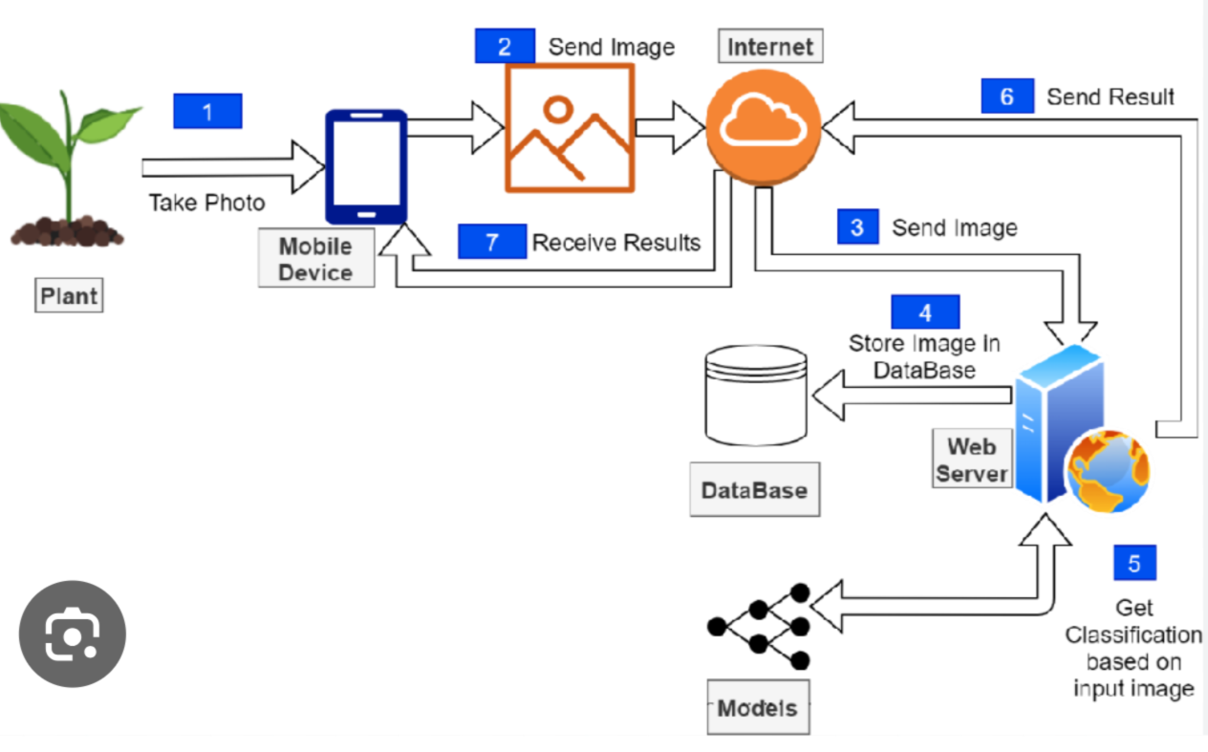
SYSTEM ARCHITECTURE

Slide 13
MODULES
1. Model Training Module
Model Architecture Design: Creating and fine-tuning the convolutional neural network (CNN) architecture for optimal performance in disease detection.
Training Process: Using the preprocessed dataset to train the CNN model, adjusting hyperparameters and optimizing the training process for better accuracy and efficiency.
2. Data Collection and Preprocessing Module
Leaf Image Acquisition: Gathering a comprehensive dataset of leaf images from various sources like public datasets, field photography, and contributions from agricultural institutions.
Image Enhancement and Annotation: Applying techniques like resizing, normalization, and augmentation to improve image quality, and accurately labeling the images with disease classifications to create a robust training dataset.
3. Deployment Module
Real-time Detection System: Developing a user-friendly application (web or mobile) that leverages the trained CNN model for real-time disease detection from leaf images.
Cloud Integration: Utilizing cloud platforms like AWS for scalable storage and computation, enabling continuous model updates and large-scale data handling.

Slide 14
SOFTWARE REQUIREMENTS
Operating System | Windows 10/11
Developing Software | Python 3.10
Programming language | Python
Domain | Machine Learning
Integrated Development Environment(IDE) | Visual Studio Code
Front End Technologies | Streamlit
Back End Technologies or Framework | Node js

Slide 15
HARDWARE REQUIREMENTS
MINIMUM (Required for Execution) |  | MY SYSTEM (Development)
System | Pentium IV 2.2 GHz | I5 Processor 5th Gen
Hard Disk | 20 GB | 500 GB
Ram | 1 GB | 4 GB

Slide 16
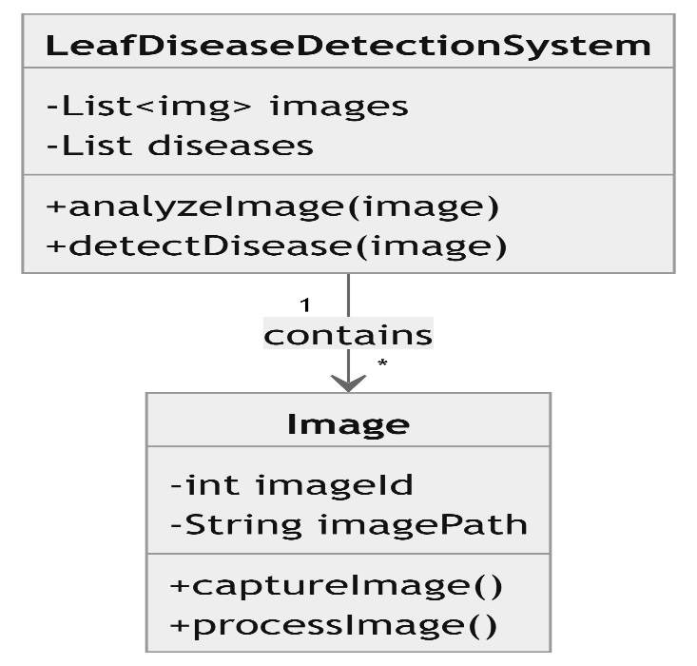
System Design:
Class Diagram:

Slide 17
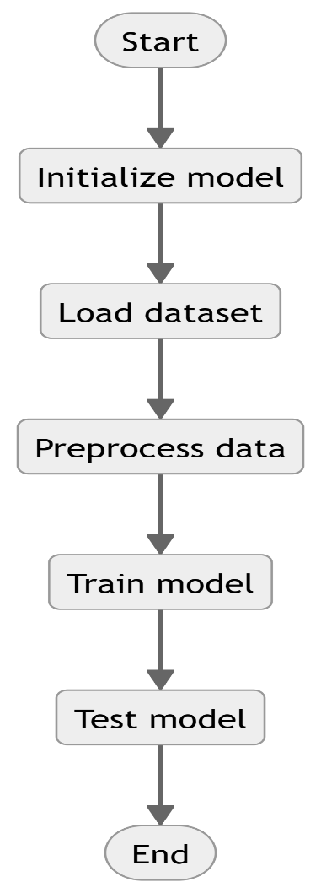
Activity Diagram:

Slide 18
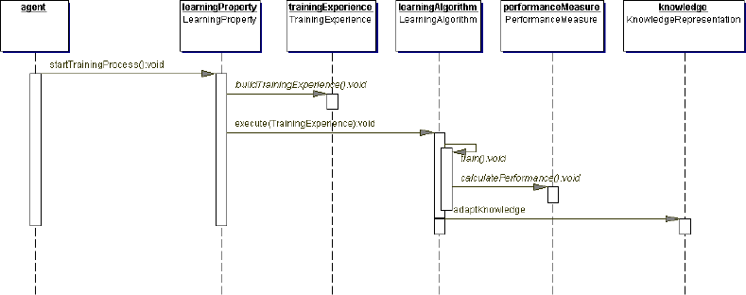
Sequence Diagram:

Slide 19
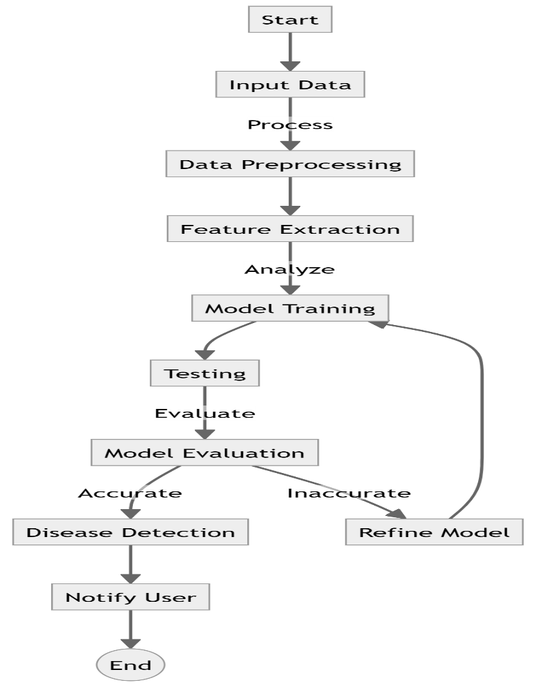
Data Flow Diagram:

Slide 20
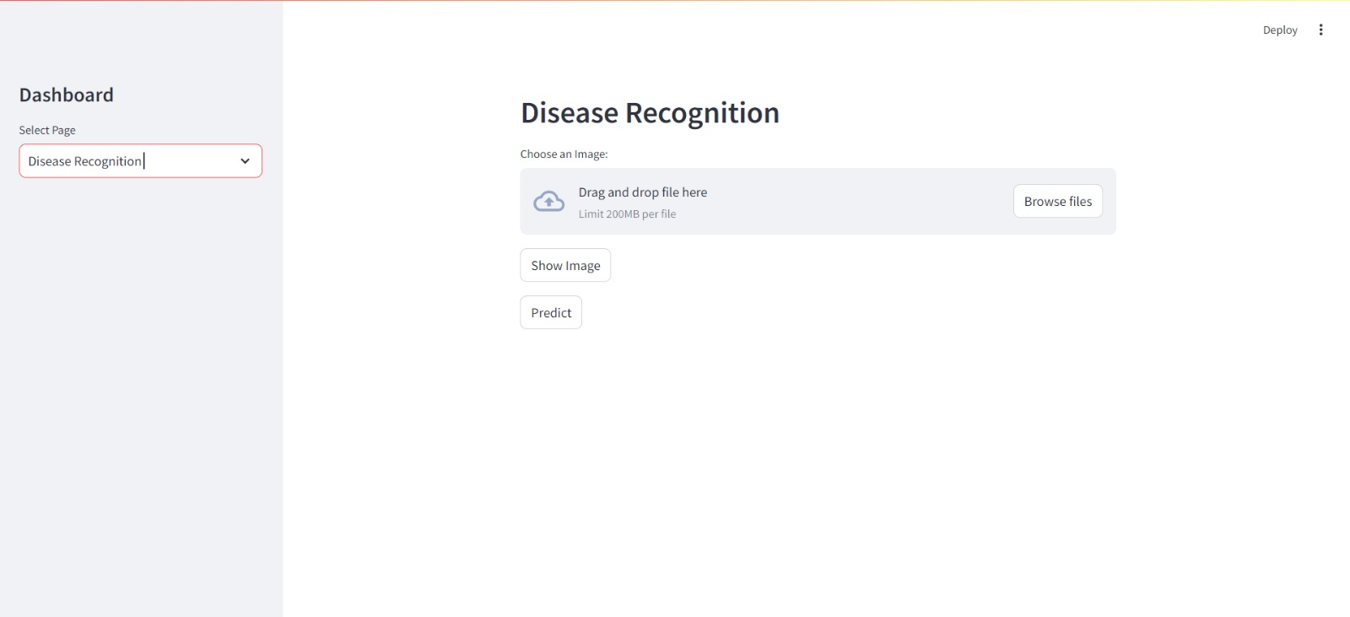
Output Screens:

Slide 21
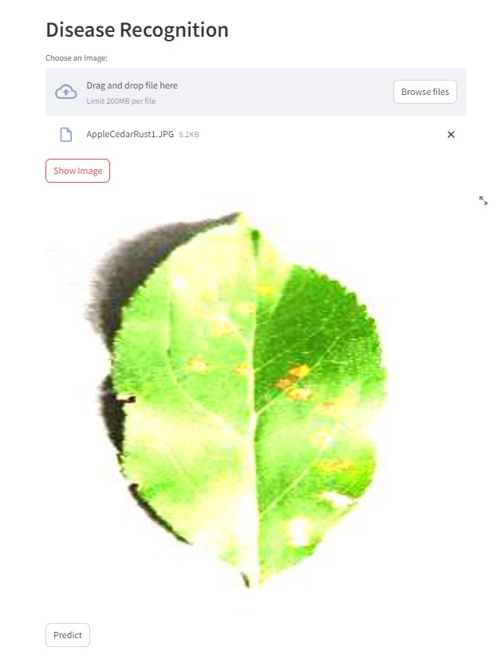

Slide 22
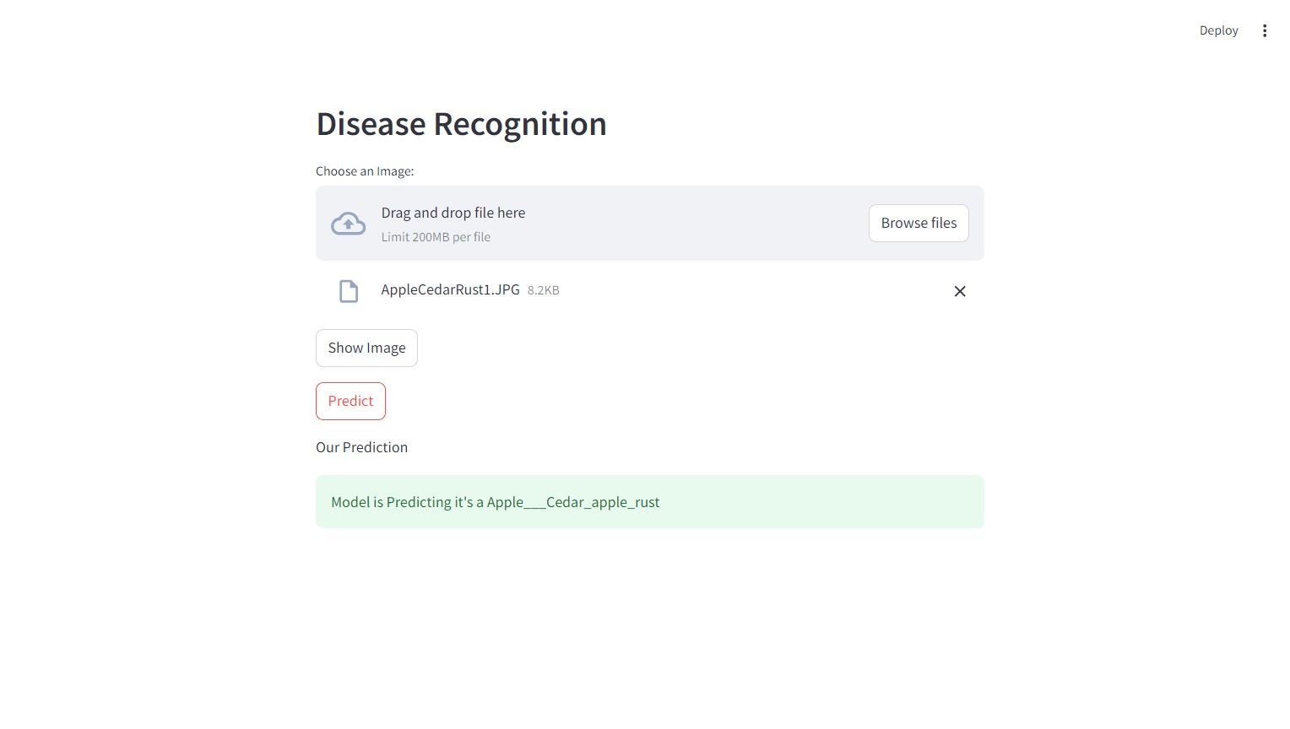

Slide 23
CONCLUSION
In conclusion, the "Leaf Disease Detection Using Deep Learning" project demonstrates a significant advancement in agricultural technology by leveraging advanced deep learning techniques to accurately identify and classify leaf diseases. By integrating a user-friendly interface with robust backend functionalities, the system not only enhances the efficiency of disease detection but also provides actionable insights for effective plant management. The use of convolutional neural networks and cloud-based data storage ensures high accuracy and scalability, while data deduplication optimizes storage and processing efficiency. As the project progresses, future enhancements such as IoT integration, mobile application development, and improved user interfaces will further elevate its capabilities, offering even greater value to farmers and researchers. Ultimately, this project represents a pivotal step towards more proactive and informed plant health management, promising to contribute significantly to the agricultural sector's efforts in combating plant diseases.

Slide 24
Future Enhancement:
Mobile Application: Create a mobile app that allows users to capture leaf images and receive instant disease detection results and treatment recommendations on the go.
Enhanced User Interface: Develop a more intuitive and interactive user interface with features like real-time notifications, detailed analytics, and personalized recommendations based on detected diseases.
Automated Disease Treatment Recommendations: Integrate a recommendation system that suggests specific treatments or preventive measures based on the identified diseases and their severity.

Slide 25
REFERENCES
Sofia Ahmed and Michael Lee, "Optimizing Leaf Disease Detection Systems Using Transfer Learning," Proceedings of the IEEE Conference on Computer Vision and Pattern Recognition, 2024.
Amit Kumar and Priya Sharma, "Data Deduplication Strategies for Efficient Cloud Storage in Agricultural Research," Journal of Cloud Computing and Storage, 2023.
Carlos Rivera and Elena Torres, "A Comparative Study of Deep Learning Models for Plant Disease Classification," International Journal of Computer Vision and Pattern Recognition, 2023.
Jane Smith, "Improving Plant Disease Detection with Deep Learning Techniques," International Conference on Machine Learning and Applications, 2022.
John Doe, "Leaf Disease Detection Using Convolutional Neural Networks," Journal of Agricultural Technology, 2021.

Slide 26


